Slide 1

TOMP API
Use case driven

Slide 2
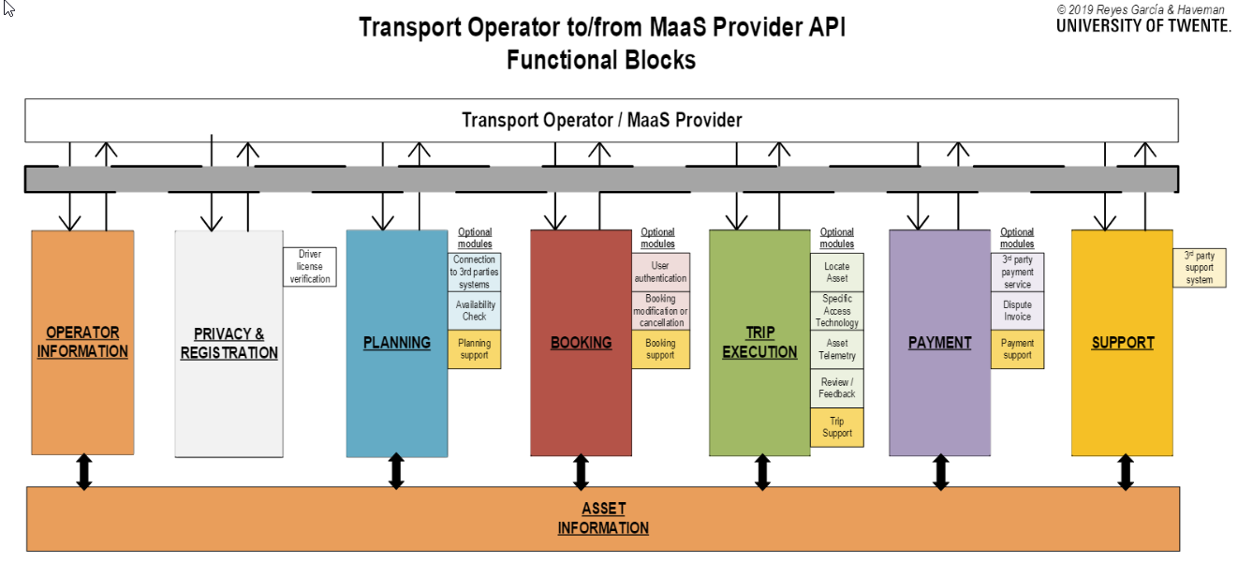
Modular setup

Slide 3
TOMP modules vs use cases
Instead of focusing on modules, we should describe use cases
Each use case will result in (a few) endpoint(s)
First question: what’s the use case for a MVP?
Answer: being able to use an asset
How does this relate to the TOMPs endpoints?
All of the Operator Information (or other standard): yes
Inquiry: not necessary
Offer & booking: yes, the traditional flow
One-stop-booking: the other option
Booking event: dependent on the process identifier ‘AUTO_COMMIT’

Slide 4
Base use case: plan & book
Plan / book : multiple ways to (plan &) book
Investigate
what’s there (high performance, for route planning purposes)
One stop booking
Directly book, based on (external) data sources or route planning results
Offers
Create offers, book them
Buy a travel product
Version 2.0?

Slide 5
When to use offers?
You offer multiple types of assets for the requested leg
You offer multiple options for payment/pricing for the requested leg, depending on personal aspects or reduction cards
You offer multiple routes (mostly PT)
You offer optional additional ancillary packs (helmets, insurances)
… Actually, any scenario where you want to offer multiple options to the end user …

Slide 6
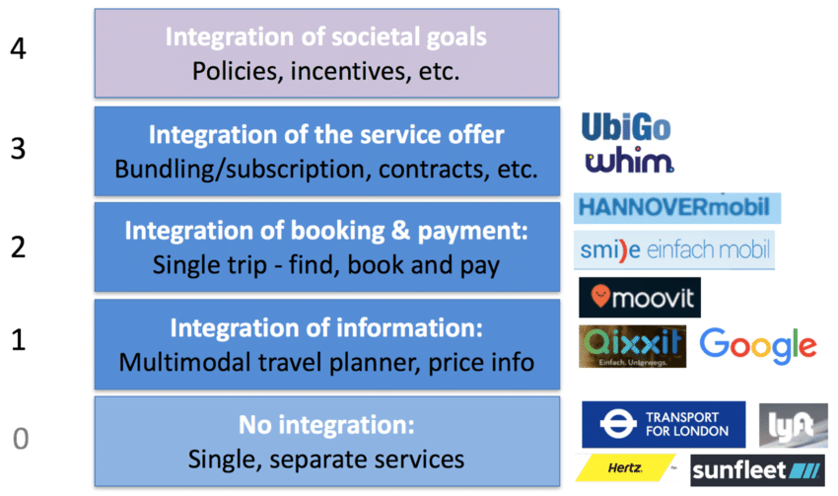
One-stop booking
Assumptions:
level 1 is done
Peer-2-peer solution & agreement
Likely scenarios:
Public transport (NeTEx)
Bike-sharing (GBFS)
Indirectly, using e.g. OTP or OJP
“I exactly know what I want”
call one-stop booking
with information from level 1
Delivers
PT: e.g. booked static ticket
Bike-sharing: opened bike

Slide 7
Implementation of base functionality
What do we need to implement?
One-stop-booking endpoint
Additional:
PT
None in case of a static ticket, provided in the result of the booking
+ Use case: trip get endpoint, when ticket is provided later (or at inspection time)
+ Use case: trip events endpoint start/finish in case swipe-on/swipe-off scenario
bike-sharing
Trip-events endpoint to start the leg, opening the bike (optional, can also be opened directly after booking, process identifier ‘<look up>’)
Trip-events endpoint to finish the leg, closing the bike

Slide 8
Bottom line: MVP
Public transport
Most simple implementation
1 endpoint: one-stop-booking
Bike-sharing
Most simple implementation:
2 endpoints: one-stop-booking & close the bike (end of trip)

Slide 9
Bottom line
Public transport
One-stop: 1 endpoint
Offers: 2 endpoint
Request offers
Book one of the offers
Bike-sharing
One-stop: 2 endpoints (book & close bike)
Offers: 3 endpoint
Request offers
Book one of the offers
Close the bike (end of trip)

Slide 10
Use cases to extend
Support multi modal booking => +1 endpoint (commit)
Support canceling a booking => +1 endpoint (same as commit!)
Support overview of payment => +1 endpoint
Support handling incidents/accidents => +2 endpoints
Support delay (departure time) => +1 endpoint
Support extend usage => +1 endpoint (same as delay)
Support modifying ancillaries => +2 endpoints
Support select an asset at departure time => +2 endpoints
Support advanced payment (claims) => +1 endpoint
Support notifications => +1 or +2 endpoints
…

Slide 11
Overview - modules
Support module
[2]
Payment overview
[1]
Extended payments
[1]
End trip [1]
Start pause trip [1]
Postpone/ extend trip
[2]
Select asset at start
[2]
Ancillaries
[2]
Notifications
[1]
Get ticket[1]
Operator information [8]
Discovery [1]
Plan & Book (one stop or offers)
[2 or 3]
P&B (commit)
[1]
P&B (cancel)
[1]
Alternative level 1 standard

Slide 12
Overview - PT
Support module
[2]
Payment overview
[1]
Extended payments
[1]
End trip [1]
Start pause trip [1]
Postpone/ extend trip
[2]
Select asset at start
[2]
Ancillaries
[2]
Notifications
[1]
Get ticket[1]
Operator information [8]
Discovery [1]
Plan & Book (one stop or offers)
[2 or 3]
P&B (commit)
[1]
P&B (cancel)
[1]
NeTEx or GTFS

Slide 13
Overview - bike
Support module
[2]
Select other asset
[2]
Payment overview
[1]
Extended payments
[1]
End trip [1]
Start pause trip [1]
Postpone/ extend trip
[2]
Select asset at start
[2]
Ancillaries
[2]
Notifications
[1]
Get ticket[1]
Operator information [8]
Discovery [1]
Plan & Book (one stop or offers)
[2 or 3]
P&B (commit)
[1]
P&B (cancel)
[1]
GBFS [8]

Slide 14
Overview - taxi
Support module
[2]
Payment overview
[1]
Extended payments
[1]
End trip [1]
Start pause trip [1]
Postpone/ extend trip
[2]
Select asset at start
[2]
Ancillaries
[2]
Notifications
[1]
Get ticket[1]
Operator information [8]
Discovery [1]
Plan & Book (one stop or offers)
[2 or 3]
P&B (commit)
[1]
P&B (cancel)
[1]

Slide 15
Overview - parking
Support module
[2]
Payment overview
[1]
Extended payments
[1]
End trip [1]
Start pause trip [1]
Postpone/ extend trip
[2]
Select asset at start
[2]
Ancillaries
[2]
Notifications
[1]
Get ticket[1]
Operator information [8]
Discovery [1]
Plan & Book (one stop or offers)
[2 or 3]
P&B (commit)
[1]
P&B (cancel)
[1]
SPDS or APDS

